Slide 1
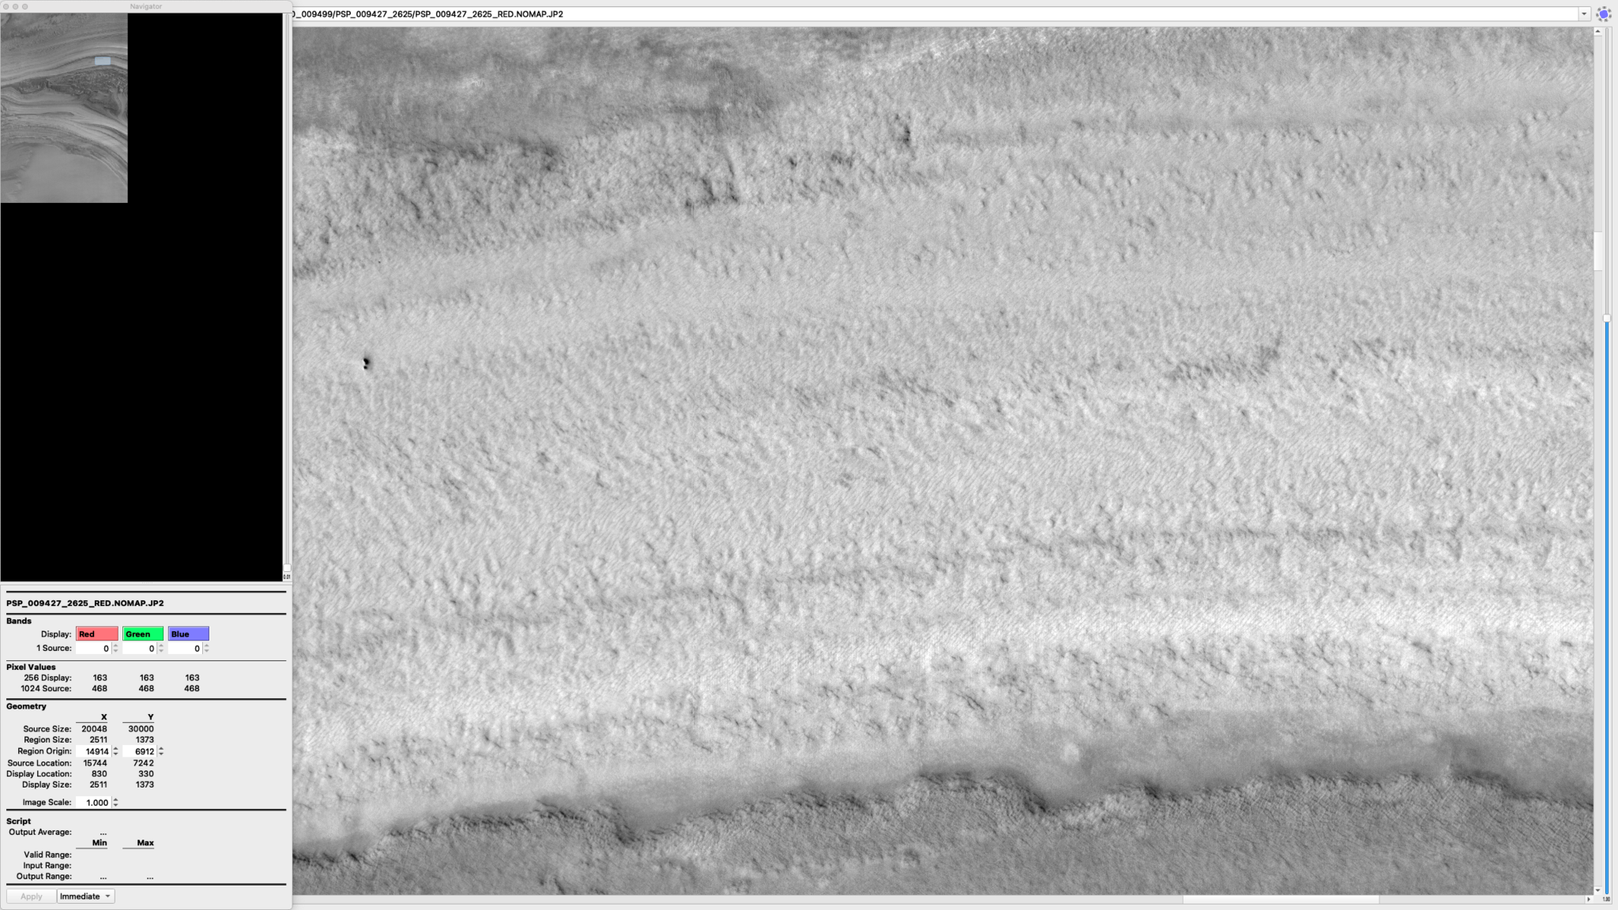
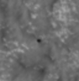
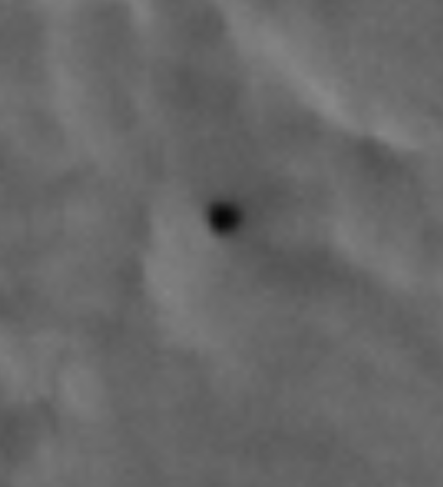
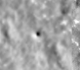
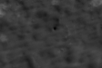
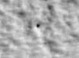
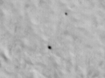




1
Mapping Enigmatic Pits in the North Polar Layered Deposits of Mars
1.5m
PSP_009427_2625
ESP_036776_2620
Dora Elalaoui-Pinedo
Dr. Sarah Sutton
Lunar and Planetary Laboratory, HiRISE, University of Arizona
University of Arizona
April 20, 2024
1.3m
ESP_036776_2620
All images from: uahirise.org

Slide 2
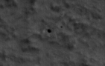
The Polar Pits
2
1.5m
Investigating enigmatic meter-scale pits in North Polar Layered Deposits (NPLD) of Mars.
View HiRISE (High Resolution Imaging Science Experiment) images aboard the NASA Mars Reconnaissance Orbiter.
Locating pits and mapping them in attempt to understand their formation mechanisms and spatial distribution among the NPLD.
Analyzing pits can reveal conclusions of active surface processes in the NPLD, potential faults, and sublimation or deposition of ice.
1.3m
2.5m
ESP_036776_2620
PSP_007373_2615
PSP_007225_2620
ESP_045231_2610
All images from: uahirise.org

Slide 3
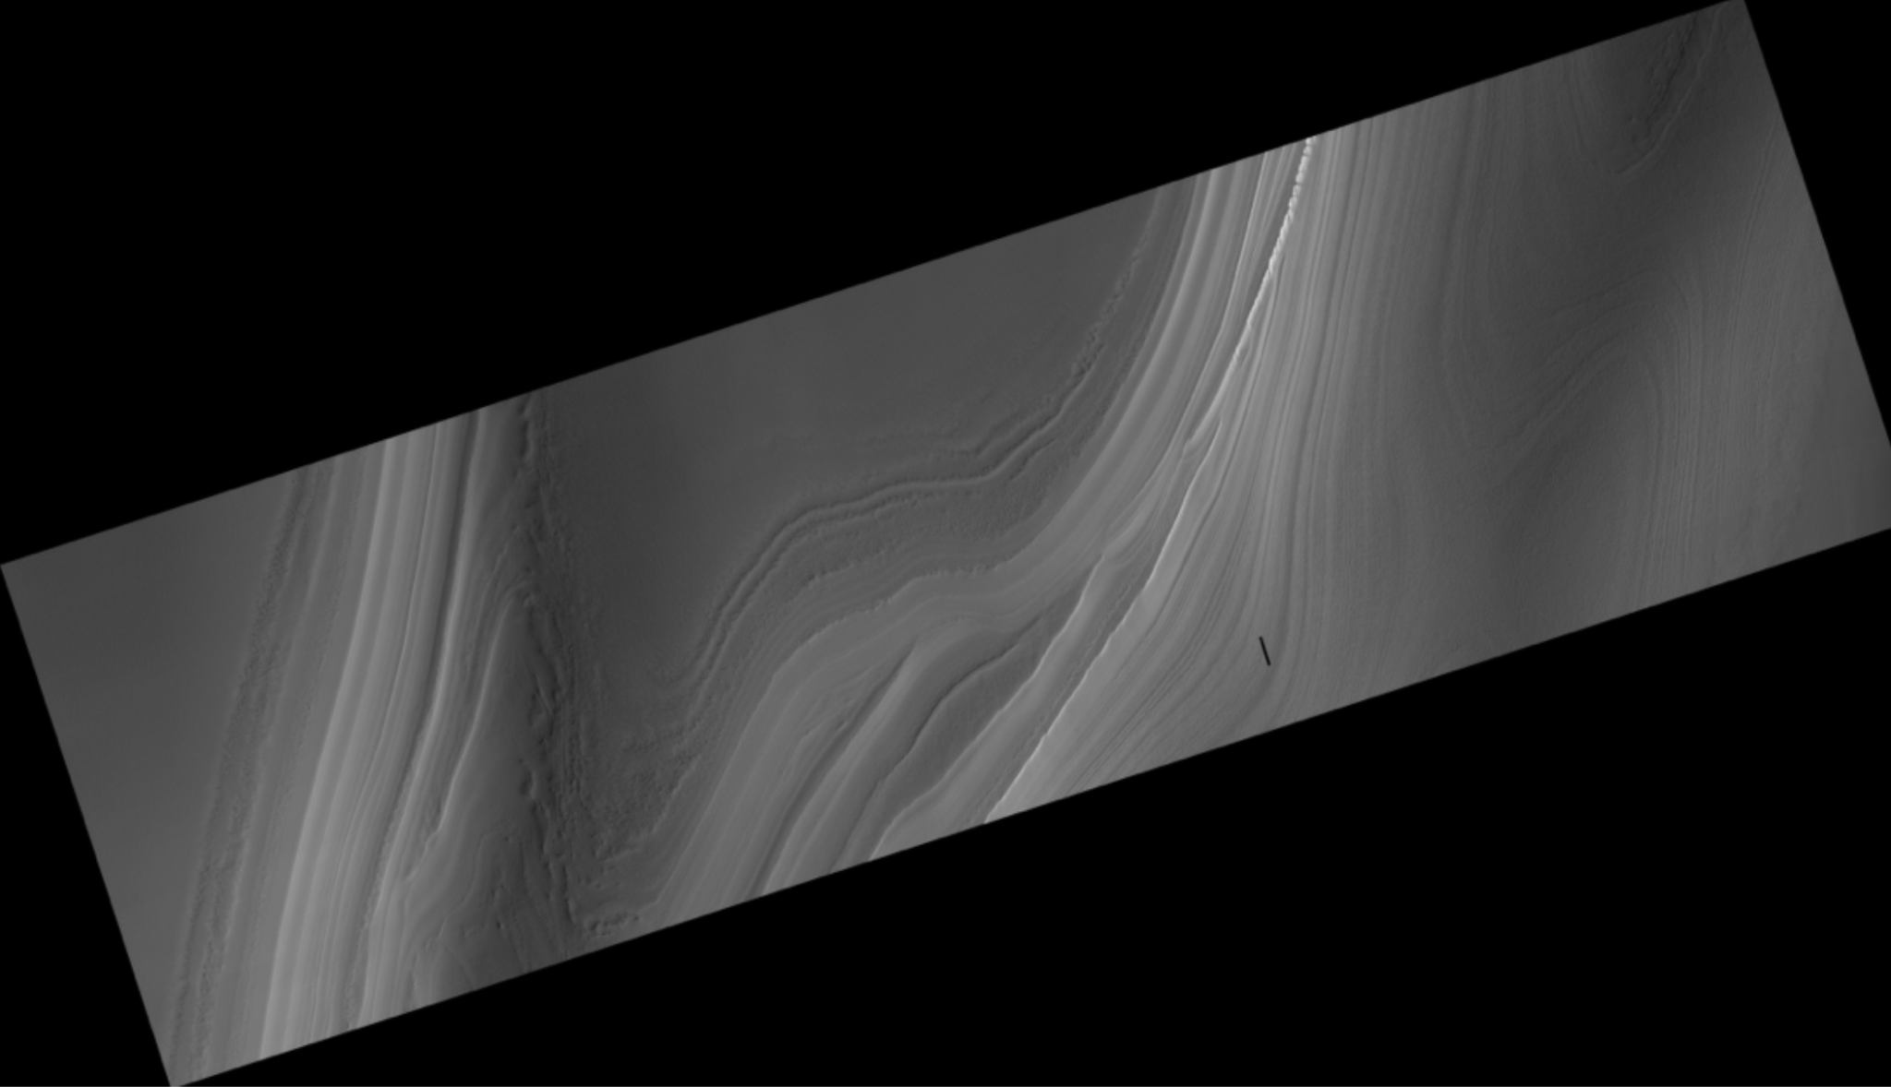
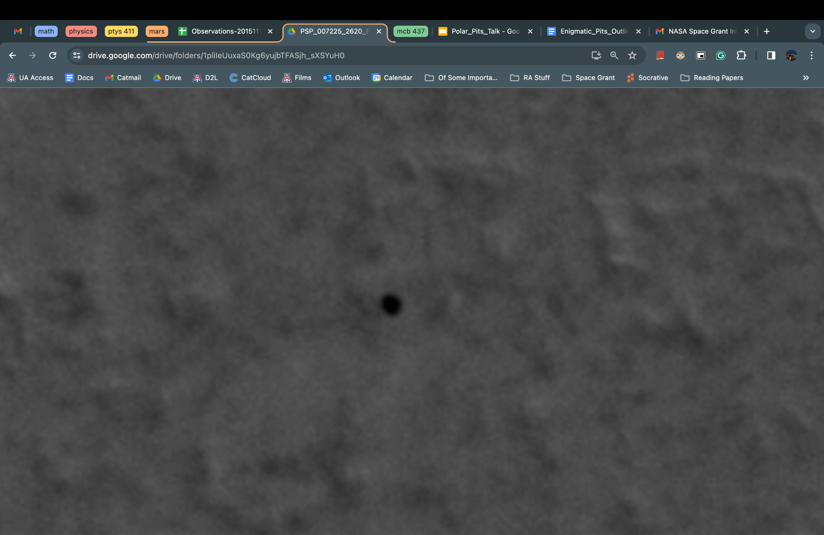
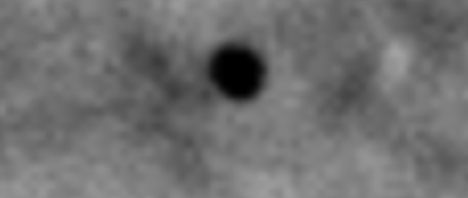
Hunting for Pits
3
Pits usually appear round or circular, meter-sized, in troughs, and as a dark hole (no light is detected within the pit).
Some pits can be recognized by light reflected off the surface around a pit that creates a light crescent outlining one side of the pit. Crescent could be a residual frost.
Approximately 1-5m in diameter.
View HiRISE images to find pits and use QGIS to map them.
PSP_007225_2620
RED
MAP PROJECTED
2 meters
2 meters
Original
Contrasted

Slide 4
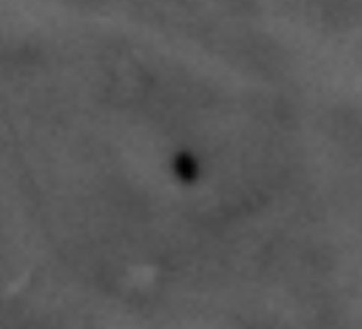
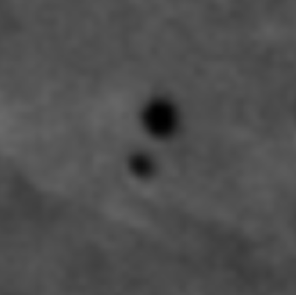
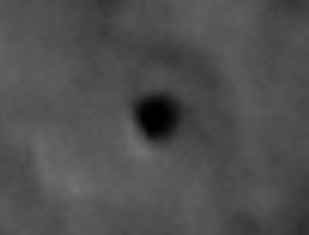
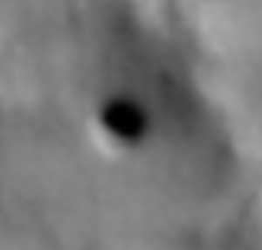
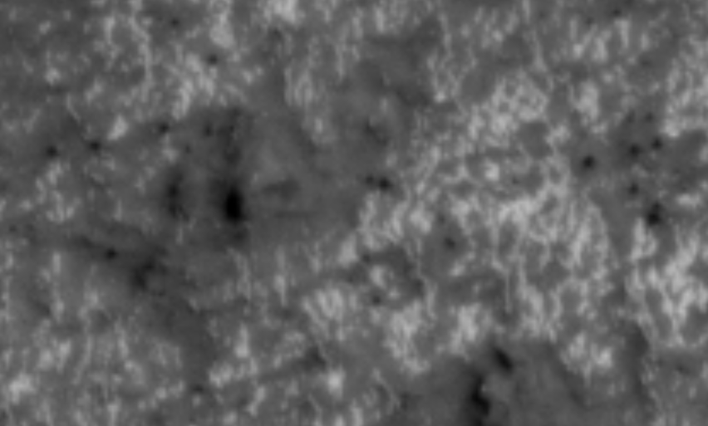
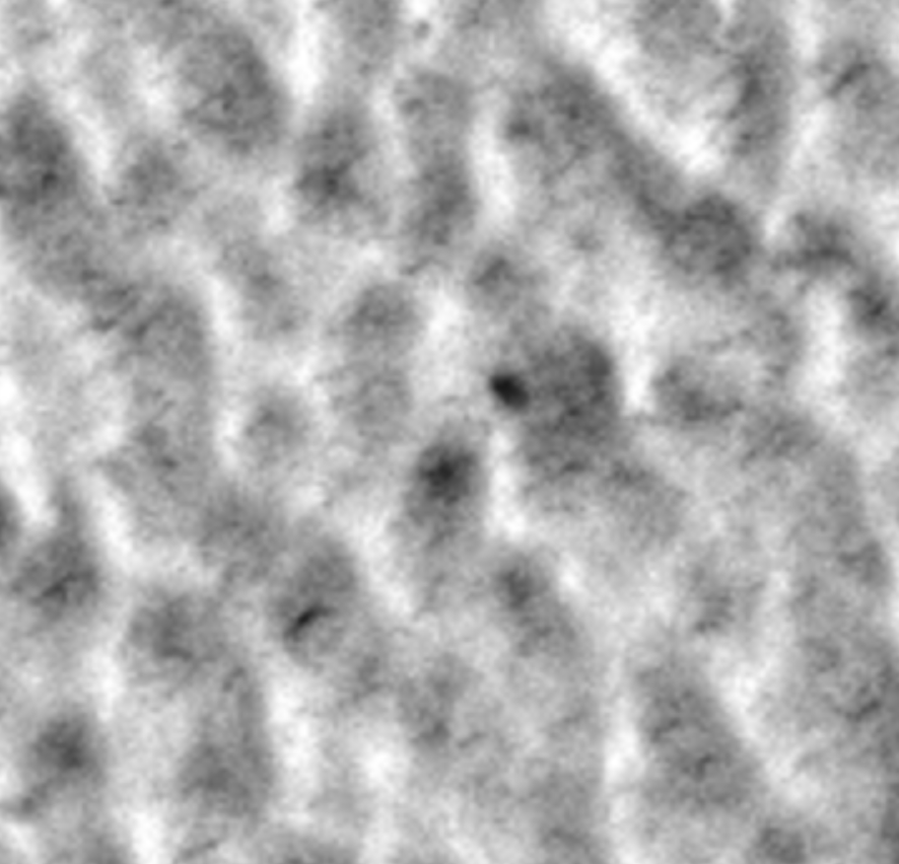
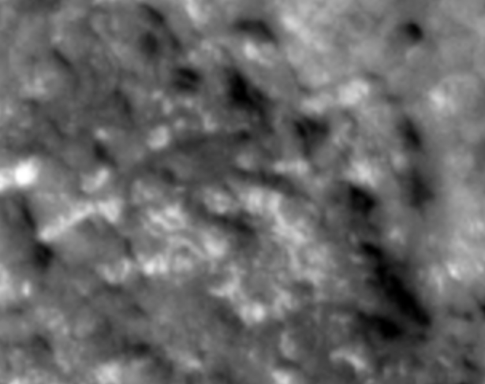
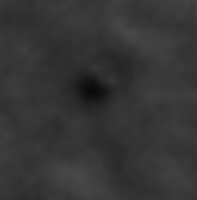
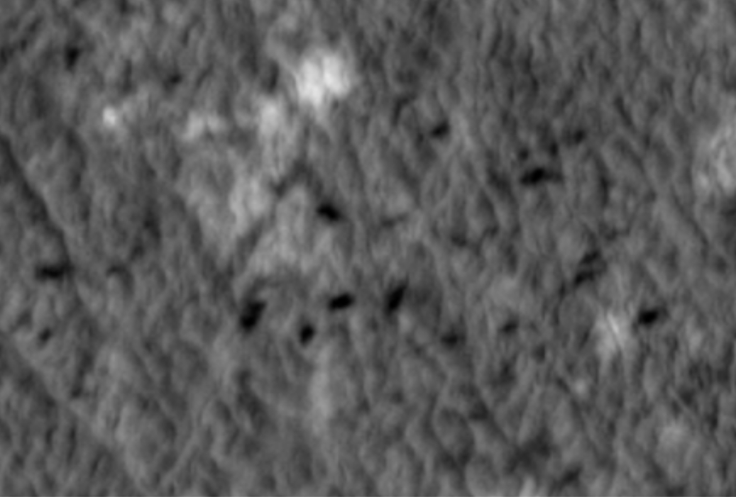
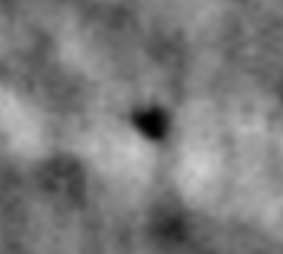
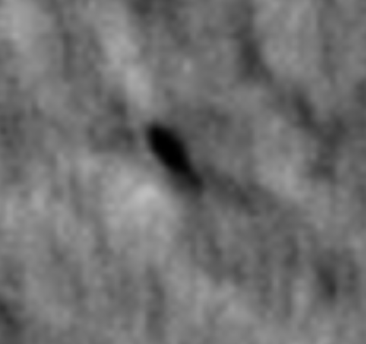
Pits
Not Pits
Possible Pits
4
ESP_016115_2590
ESP_016060_2625
PSP_007608_2630
ESP_016891_2615
ESP_036316_2590
ESP_019082_2635
ESP_044783_2585
ESP_026793_2620
All images from: uahirise.org
ESP_027205_2610
ESP_018598_2745
ESP_018598_2745

Slide 5
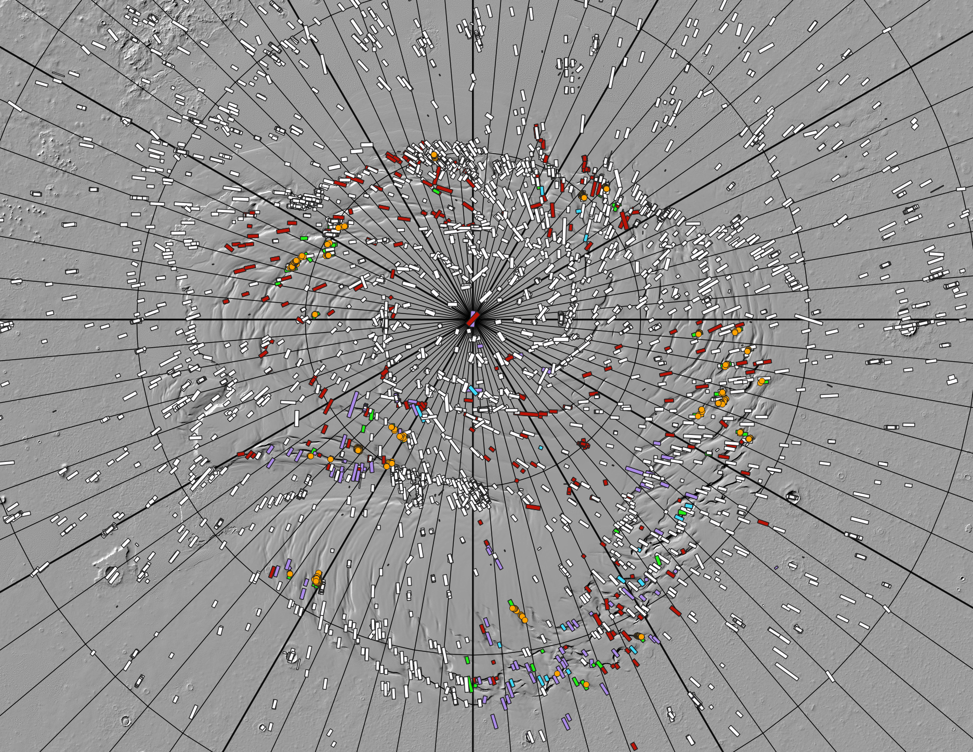
Map and Methods
210°
180°
150°
5
120°
240°
Use NPLD topography data from Mars Orbiter Laser Altimeter (MOLA) to map HiRISE image footprints and pits.
Divide map into 30° longitude bins.
270°
90°
pits found
pits not found
possible pits
Bin 2 images
pit locations
NRC pits
not viewed
300°
60°
330°
0°
30°

Slide 6
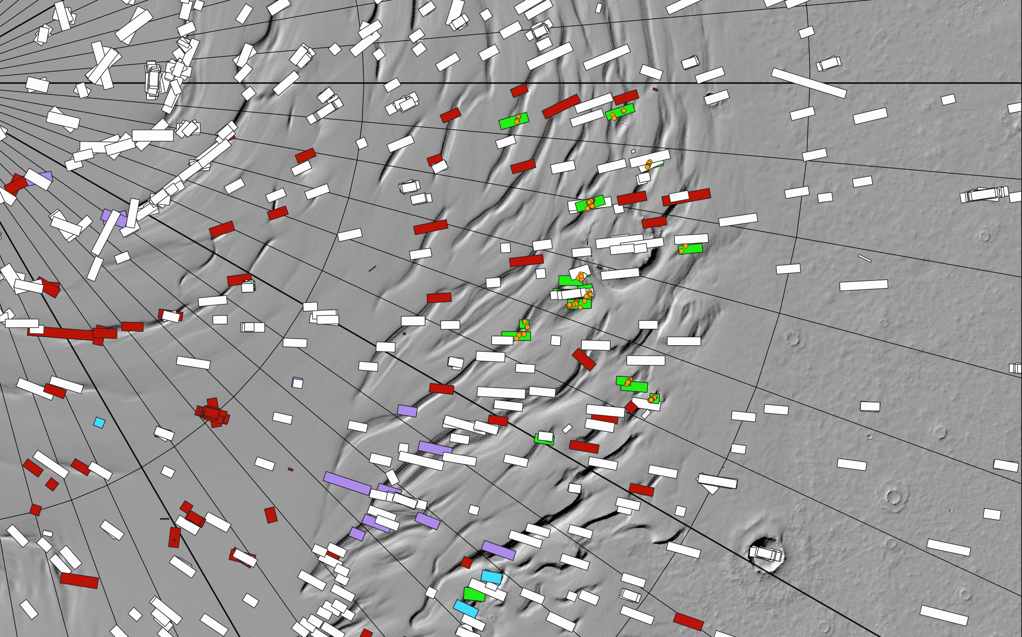
6
Map and Methods
90°
Focus on images in troughs.
Prioritize viewing highest resolution images.
pits found
pits not found
possible pits
Bin 2 images
pit locations
NRC pits
not viewed
30°
60°

Slide 7
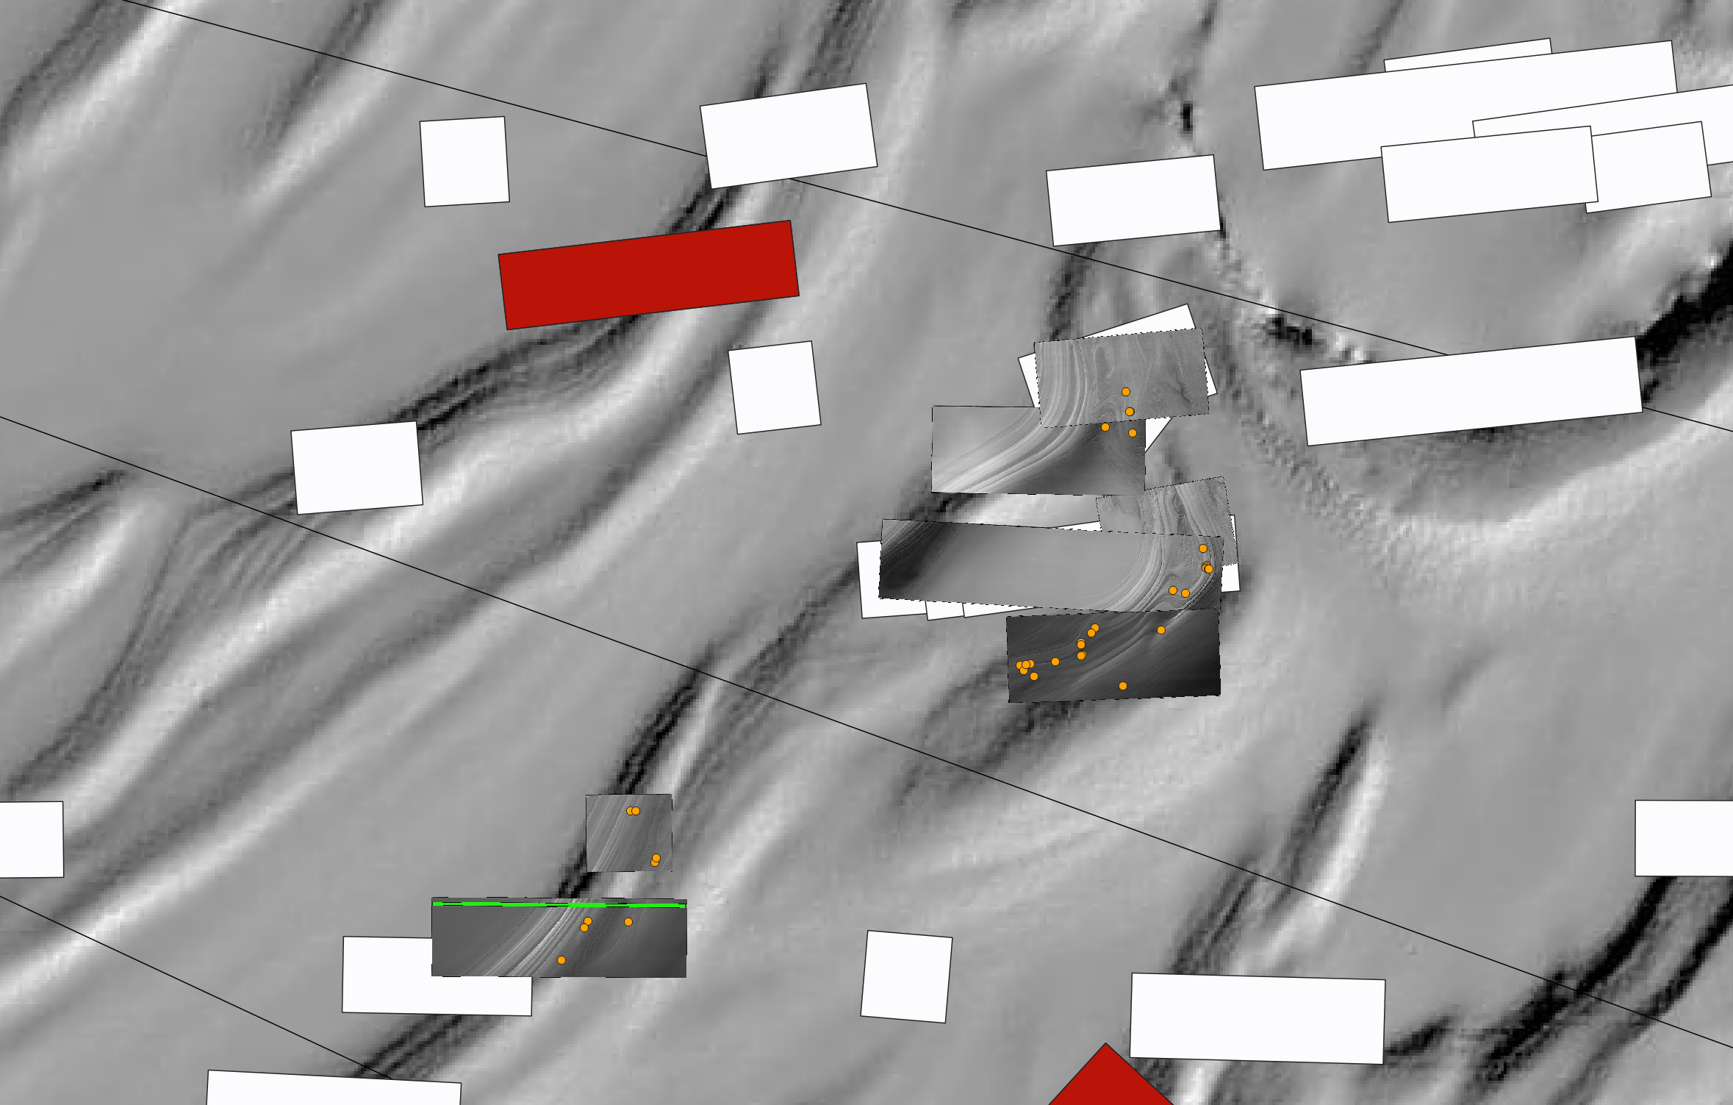
7
Map and Methods
HiRISE images are rendered onto map.
Pits are orange dots (not to scale).
pits found
pits not found
possible pits
Bin 2 images
pit locations
NRC pits
not viewed

Slide 8
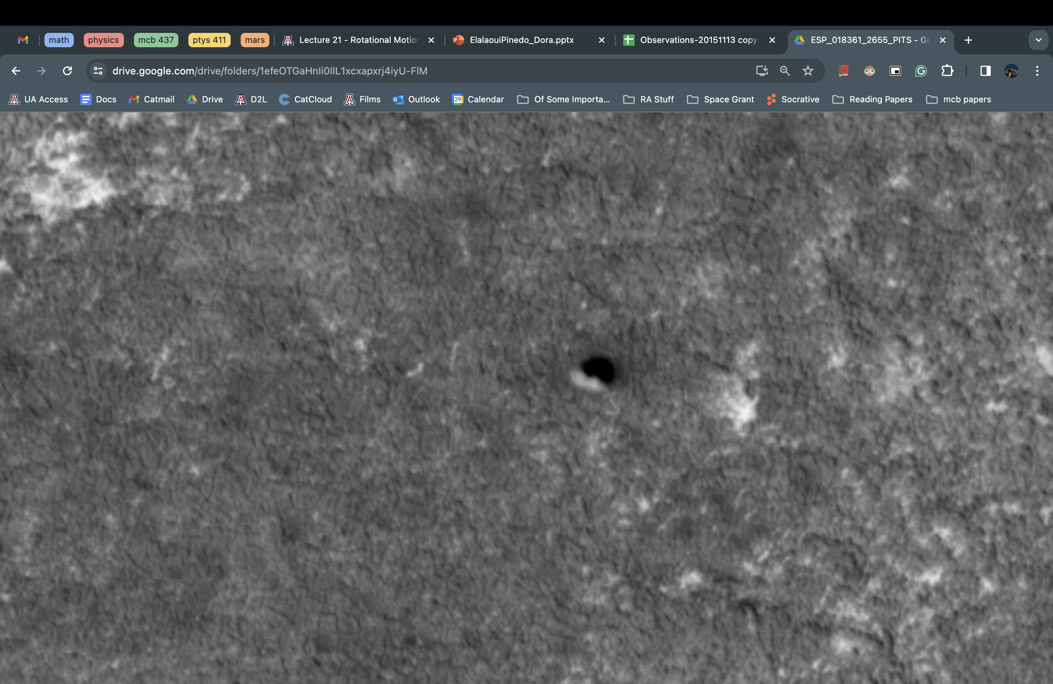
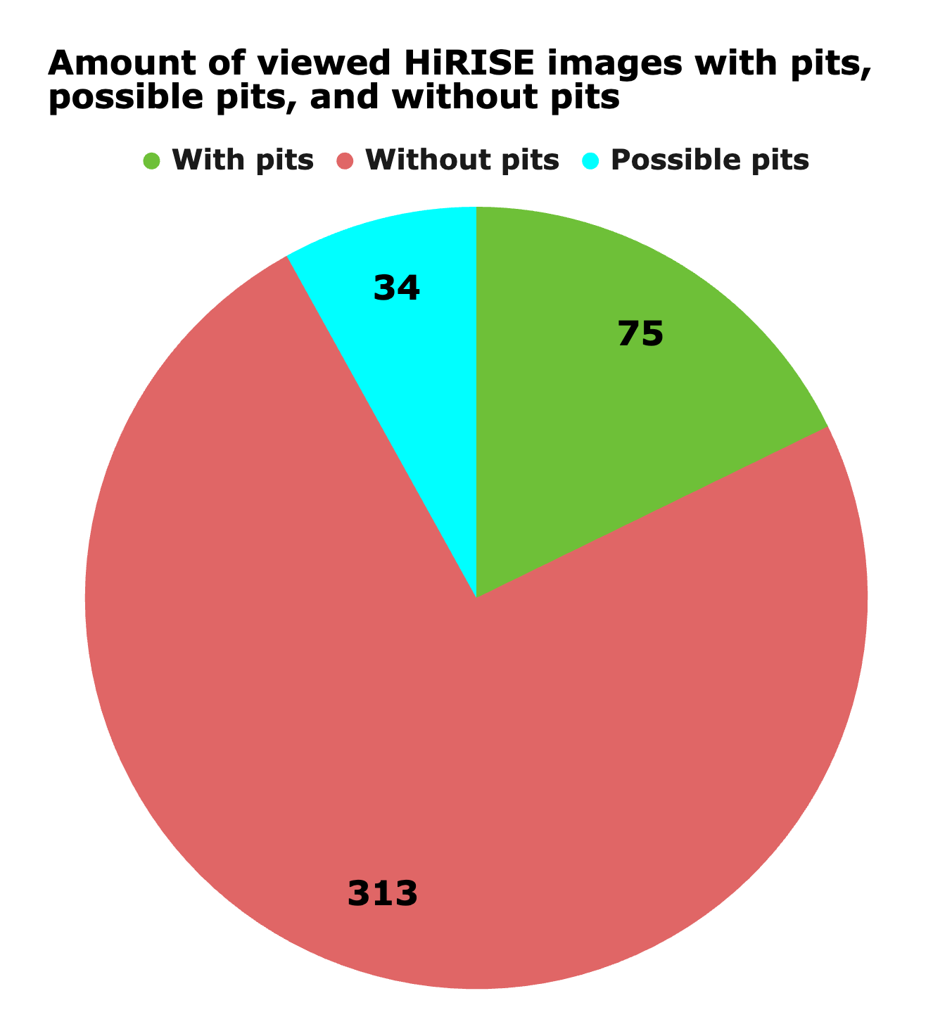
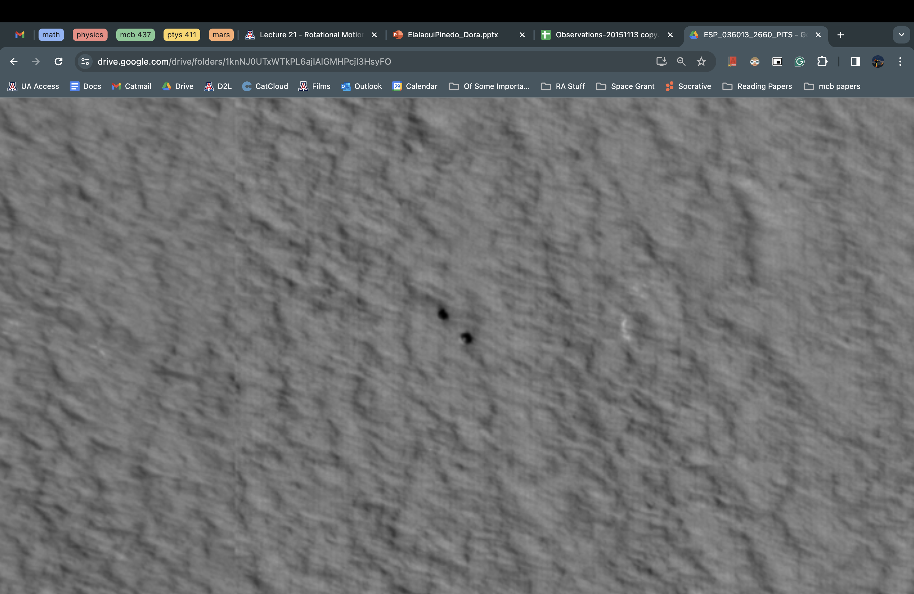
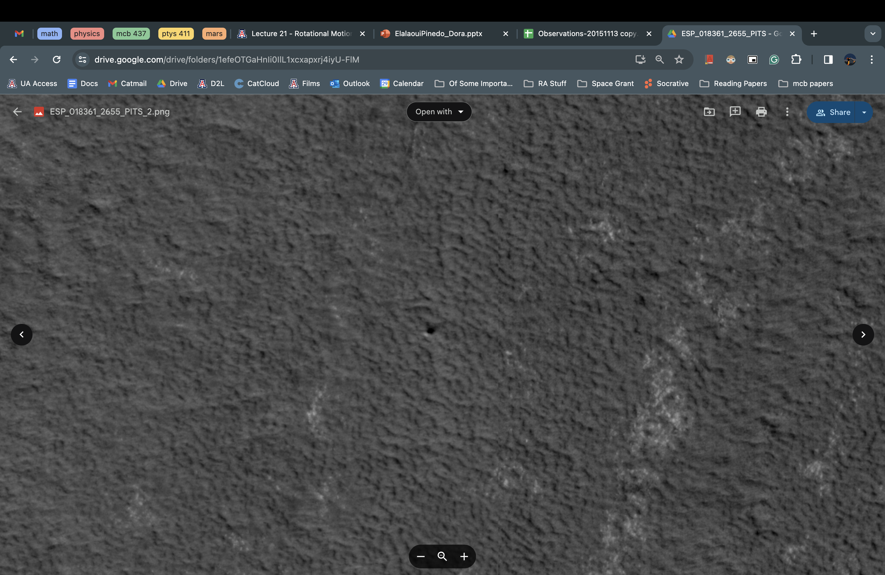
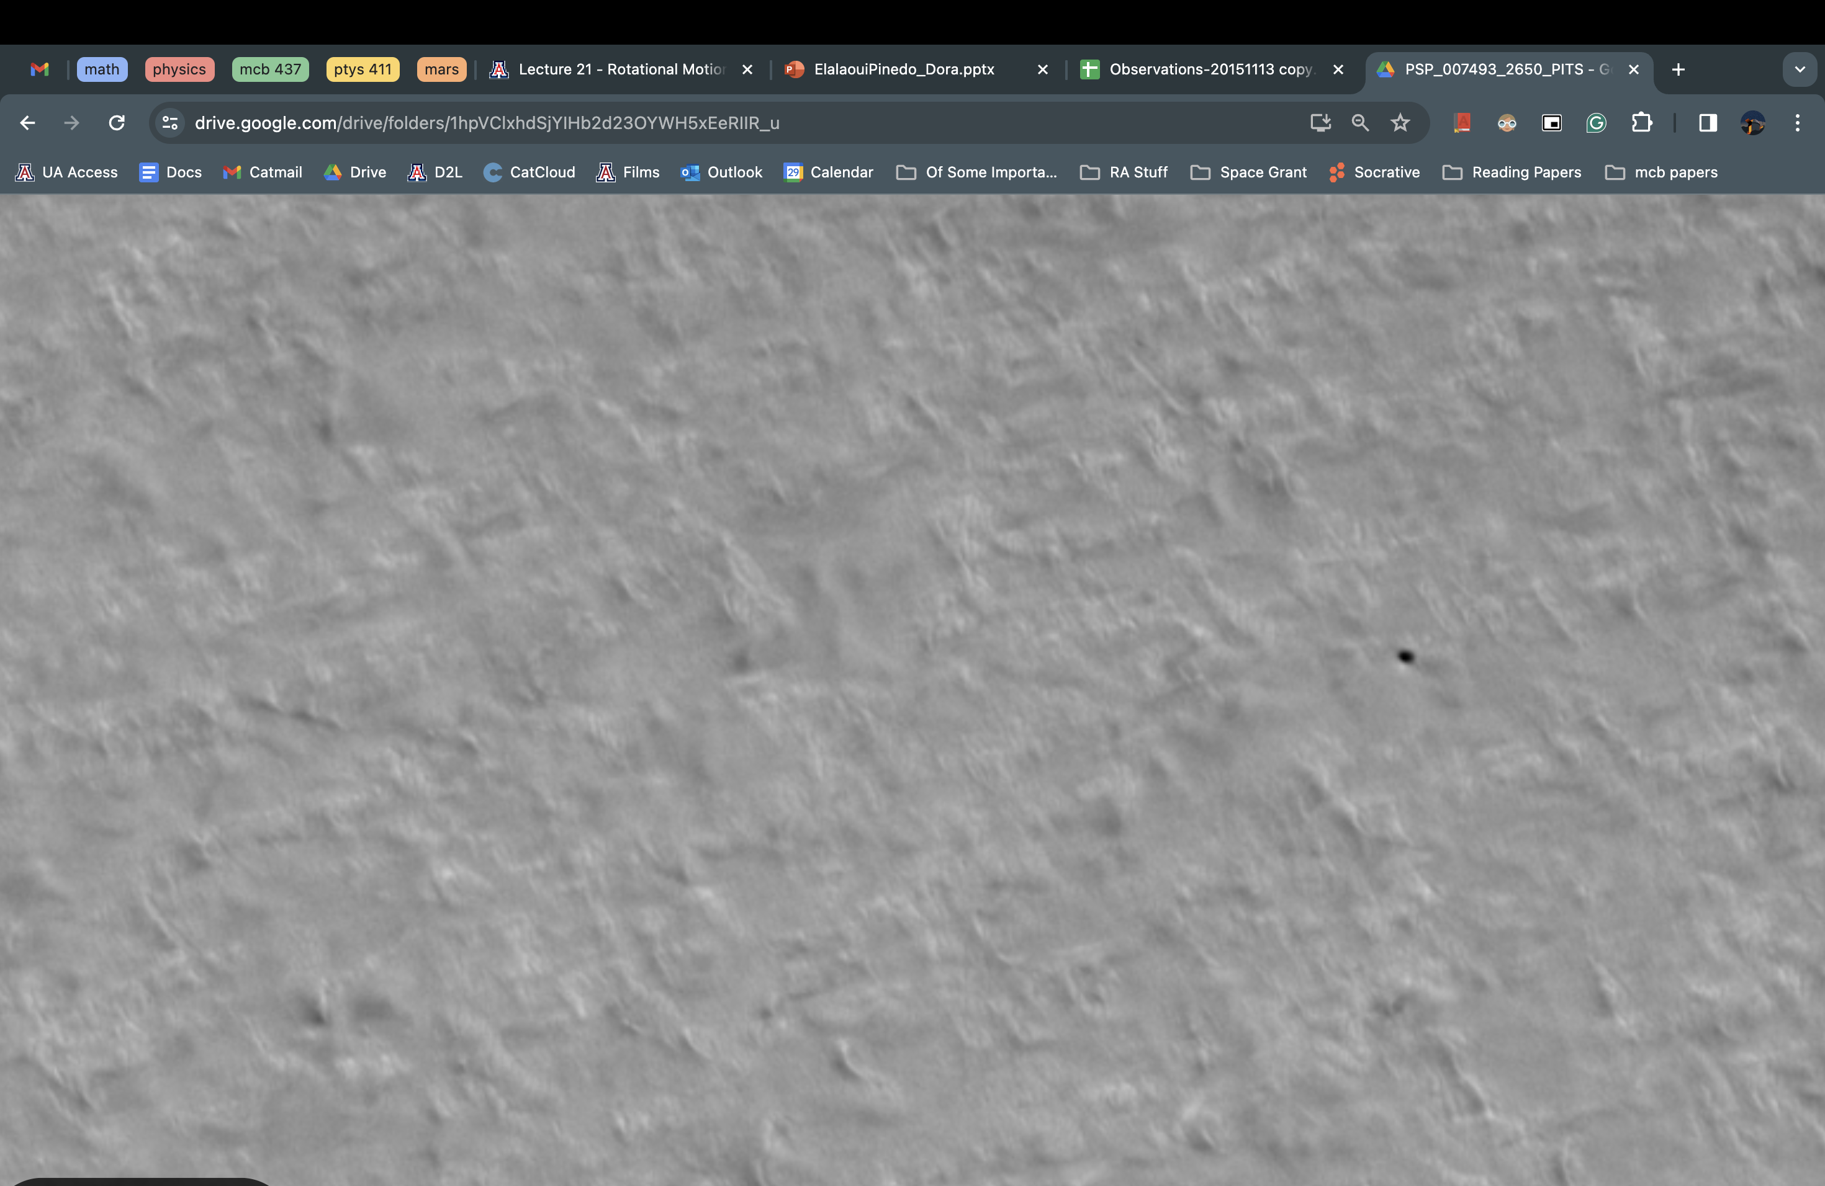
Results
8
7.6m
2,025 pits found!
Found new pits in the North Residual Cap (NRC) along a possible fault.
Pits are mainly in troughs.
Have not found pits in the Basal Unit (BU).
2.0m
3.2m
0.9m

Slide 9
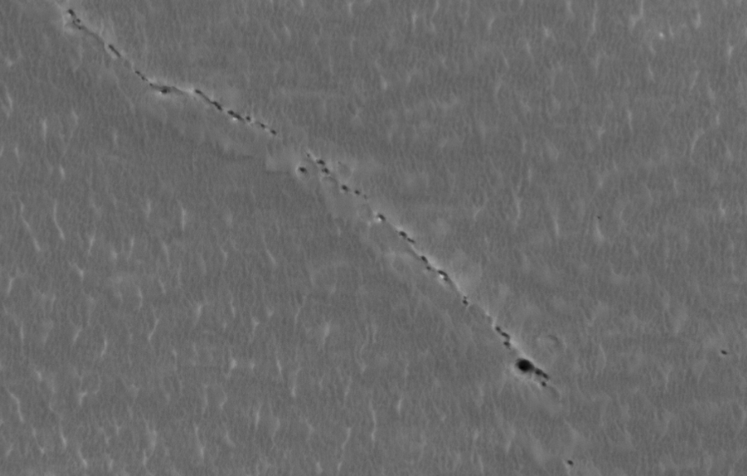
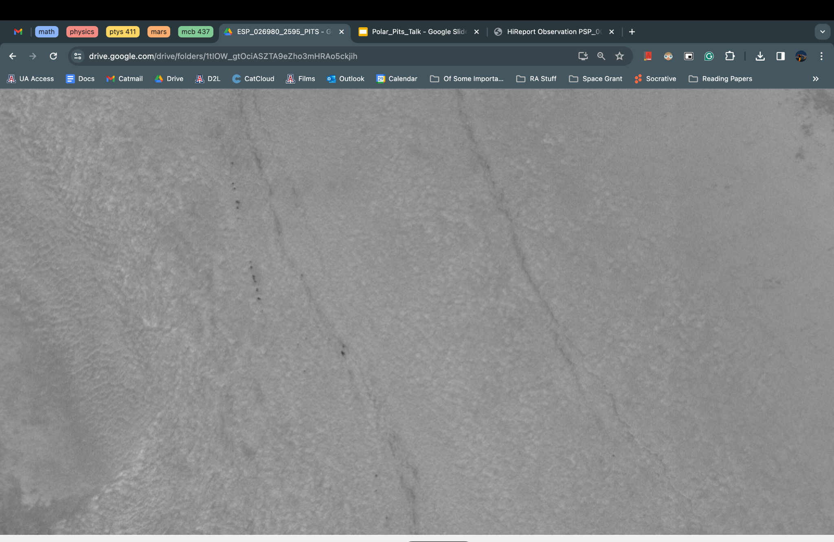
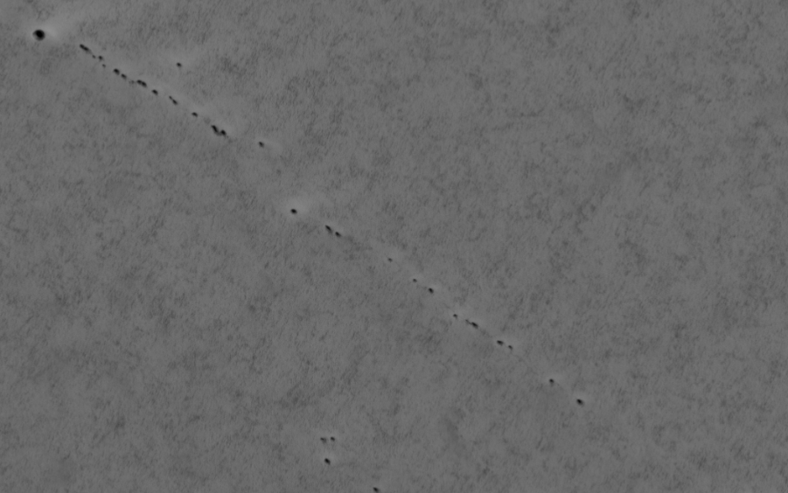
Found New North Residual Cap Pits
9
Found new pits
in the North Residual Cap (NRC) along a possible fault.​
Two locations of NRC pits were previously known.
ESP_053414_2650
138° Longitude (East)
NRC is the top layer of the NPLD.
NRC pits could have
different formation
mechanisms.​
ESP_026980_2595
28° Longitude (East)
PSP_009834_2645
134° Longitude (East)​

Slide 10
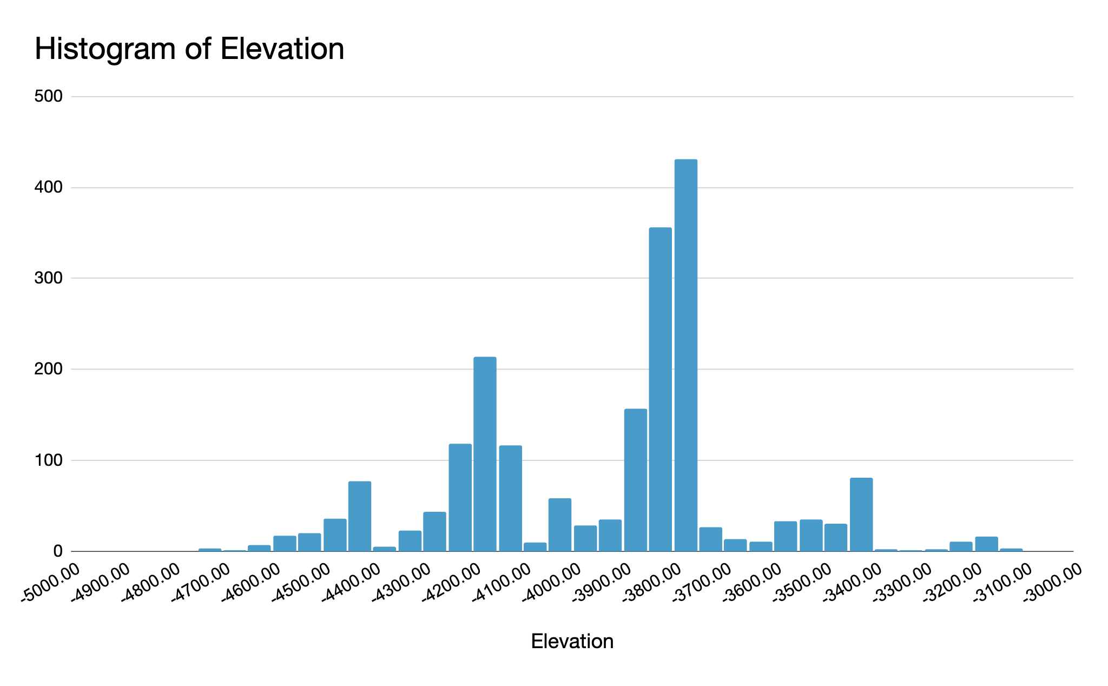
Results: Elevation of Pits
10

Slide 11
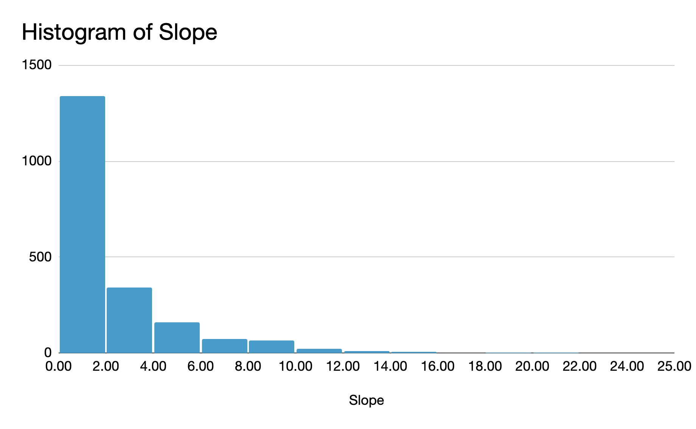
Results: Slope of Pits
11

Slide 12
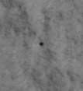
Future Directions
12
1.5m
Results from my research are novel and significant, as they provide the data to answer questions about the pits' formation.
PSP_009427_2625
We can now investigate whether the pits are occurring on equator-facing slopes or pole-facing slopes
Specific measurements of pits
Are pits found in specific layers throughout the NPLD?
Compare trough pits and NRC pits
When did pits form and are they actively forming today?
Can trends in aspect point to wind, insolation, and erosion formation processes?
1.3m
2.5m
ESP_036776_2620
PSP_007225_2620
All images from: uahirise.org

Slide 13
Acknowledgements
13
1.5m
PSP_009427_2625
Dr. Sarah Sutton 👏👏
The HiRISE Team
Lunar and Planetary Laboratory
The University of Arizona
NASA Arizona Space Grant
1.3m
PSP_007608_2630
ESP_036776_2620
ESP_045231_2610
ESP_045231_2610
PSP_007373_2615
All images from: uahirise.org

Slide 14
14
1.5m
PSP_009427_2625
Thank you!
1.3m
Dora Elalaoui-Pinedo
delisaeap@arizona.edu
PSP_007608_2630
ESP_036776_2620
ESP_045231_2610
ESP_045231_2610
PSP_007373_2615
All images from: uahirise.org

Slide 15
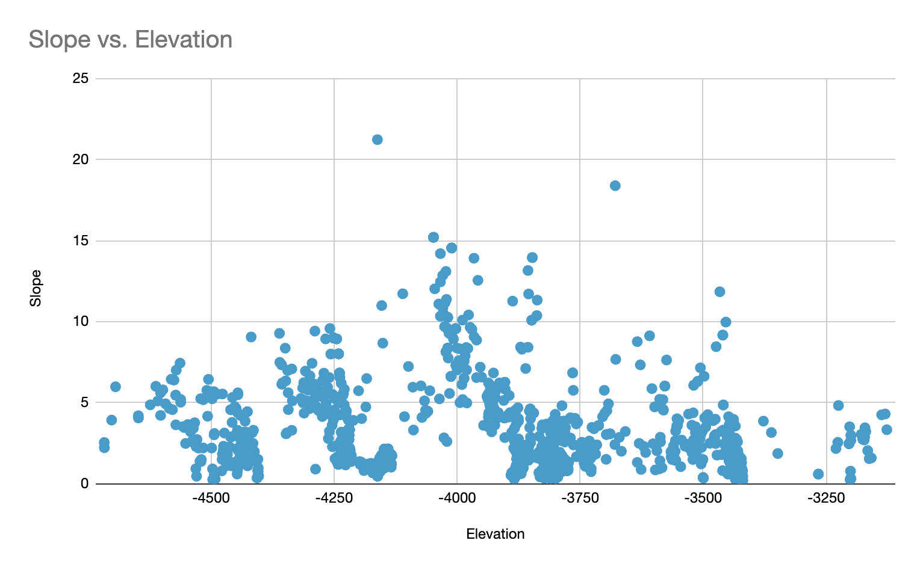
Backup Slide:
6, 743 HiRISE
images of the
Martian north
Pole
15
1.5m
PSP_009427_2625
1.3m
PSP_007608_2630
ESP_036776_2620
ESP_045231_2610
ESP_045231_2610
PSP_007373_2615
All images from: uahirise.org

